Slide 1



Amna
Breast Cancer
Let’s start!

Slide 2


Slide 3
Ai chat bot!
An interactive additional feature!
allows the patient to chat with trannig ai model to ask about anything.

Slide 4

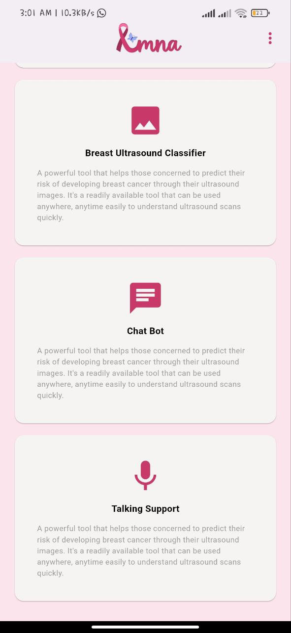
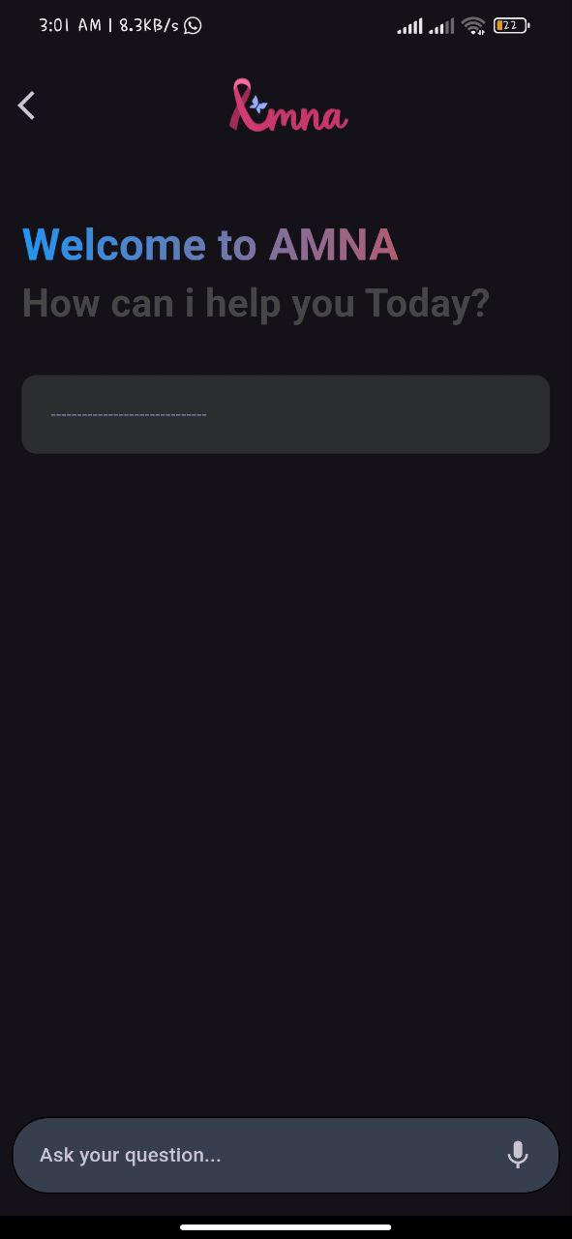
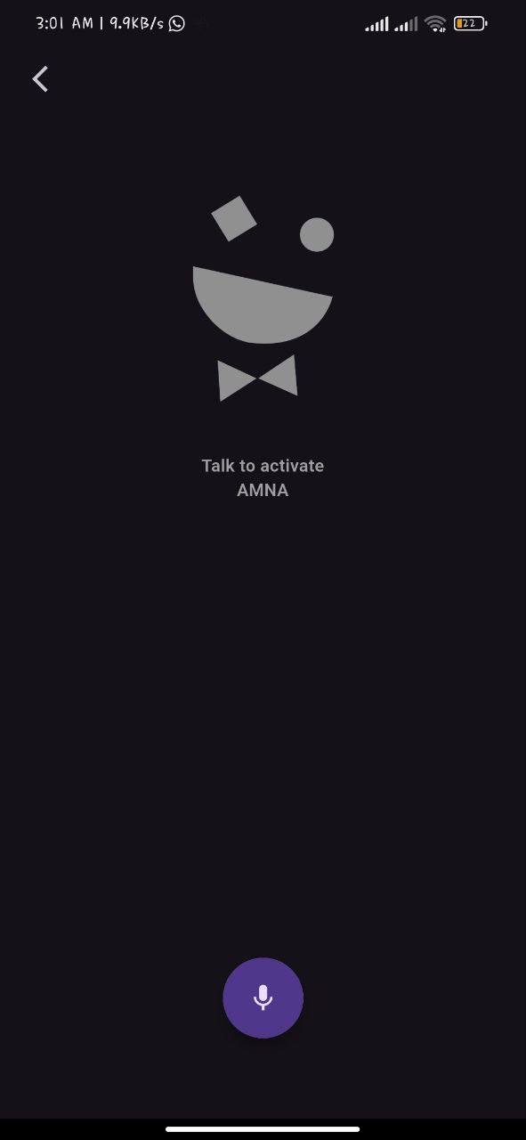



Slide 5
summary
AMNA is a comprehensive mobile app designed to assist breast cancer patients with innovative features:
CT Scan Prediction: Patients can upload their cancer X-rays, and the app uses advanced AI to predict the type of cancer.
Risk Assessment: A diagnostic feature where patients answer specific questions, helping to predict the stage of cancer (from normal to dangerous stages).
AI Chatbot: An interactive chatbot, powered by a trained AI model, allowing patients to ask questions and receive guidance on various cancer-related topics.

Slide 6



Meet the team
Our team is consists of three motivated mobile application developers.
Mohamed
Ayman
Hamdi

Slide 7


thanks
all thanks for your good listning, interactive and encouragement

